Slide 1

LJ school of computer applications SEM 08 Fundamental of Data science Presentation

Slide 2
Crypto EDA Analysis, Prediction & forecasting
Members:
Guided by:
Dr. Jignesh Doshi
Name | Enrolment no.
Arnold Macwan | 21004500210065
Manthan Parmar | 21004500210094
Hitij Vaghela | 21004500210186

Slide 3
Table of content
Introduction & Problem definition
Data Summary
EDA analysis
Scatter plot
Heatmap & histogram
Feature engineering
Moving averages
BB bands
Daily change & ATR
RSI
Random forest model
LSTM Model
GRU
Conclusion

Slide 4
Introduction
Comprehensive exploratory data analysis (EDA) and advanced financial & crypto market analysis using cutting-edge machine learning models. Includes data preprocessing, trend analysis, predictive modelling, and risk assessment techniques.

Slide 5
Problem definition
Cryptocurrency markets are characterized by significant volatility and are affected by numerous elements. This project aims to create a predictive model capable of delivering precise price predictions, assisting users in refining their trading strategies and make decisions and predict the trends (up/down) and useful insights using past market data, technical indicators and other factors

Slide 6
About data
The "Cryptocurrency Price Analysis Dataset: BTC, ETH, XRP, LTC (2018-2023)" is a comprehensive dataset that captures the daily price movements of six popular cryptocurrencies. It covers a period from January 1, 2018, to May 31, 2023, providing a valuable resource for researchers, analysts, and enthusiasts interested in studying the historical price behavior of these digital assets.
https://www.kaggle.com/datasets/adityamhaske/cryptocurrency-price-analysis-dataset/data

Slide 7
Column descriptions
Column Name | Description
Date | The date on which the price data was recorded.
Open | The opening price of the cryptocurrency at the beginning of the day.
Close | The closing price of the cryptocurrency at the end of the day.
Low | The lowest price reached by the cryptocurrency during the day.
High | The highest price reached by the cryptocurrency during the day.

Slide 8
Used libraries
Numpy and pandas
Sci-kit learn
Tensorflow
Matplotlib
seaborn

Slide 9
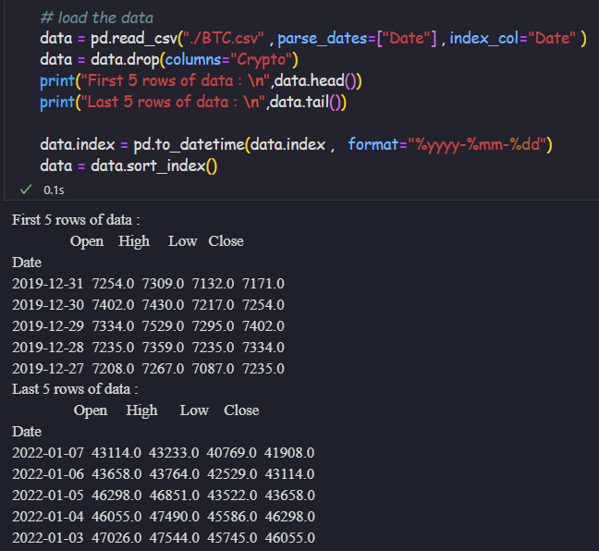
Data collection

Slide 10
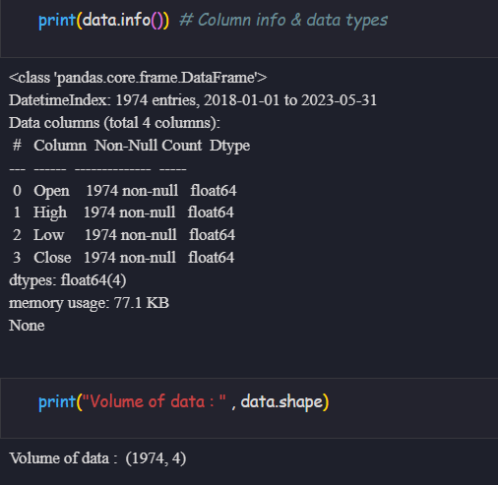
Volume & Column types

Slide 11
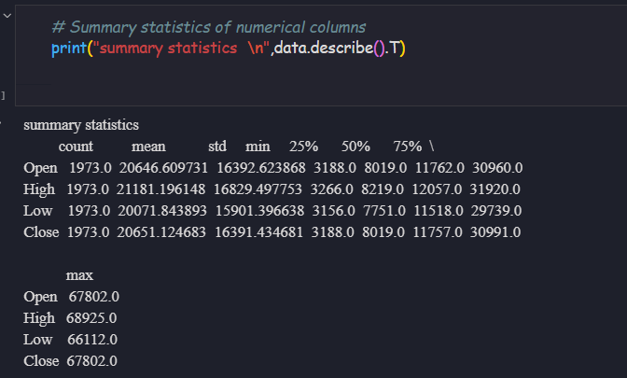
Statistical summary

Slide 12

EDA analysis

Slide 13
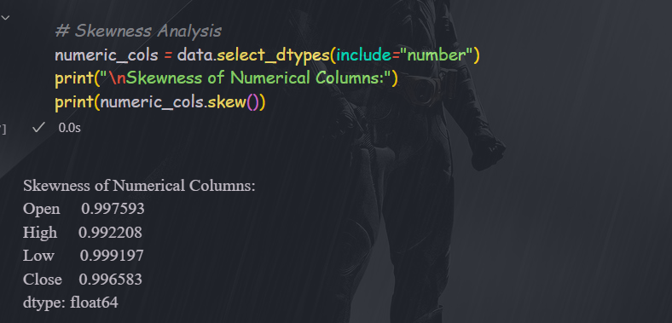
Skewness Analysis

Slide 14
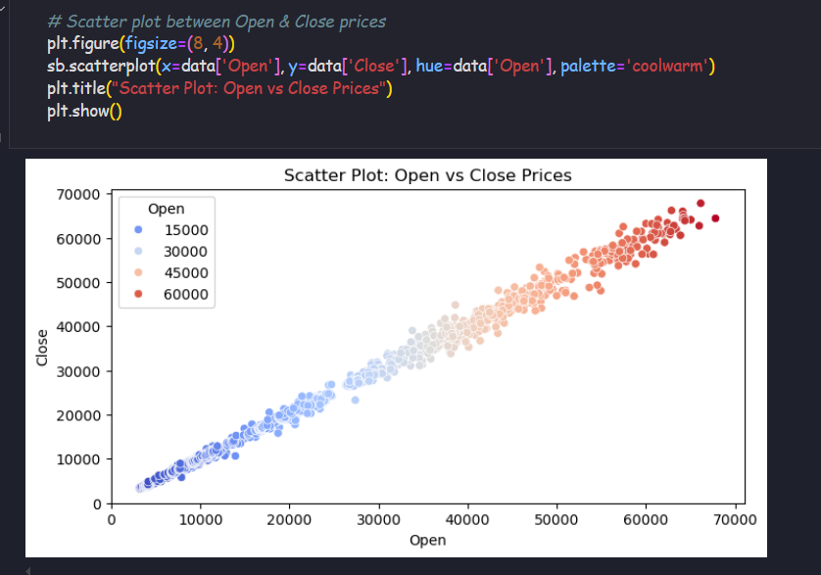
Scatter plot : open vs close

Slide 15
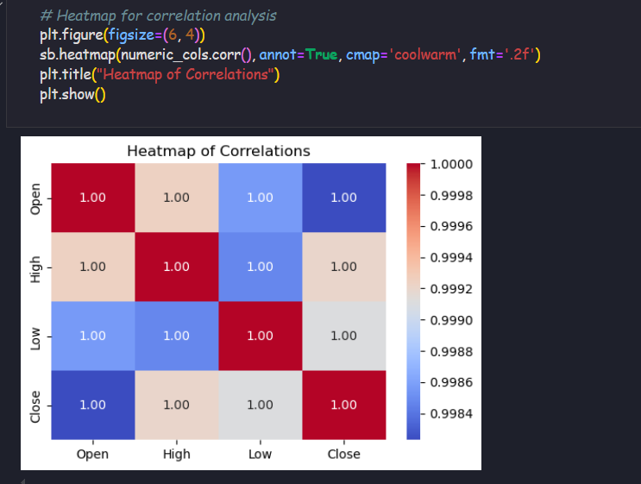
Heatmap for correlation analysis

Slide 16
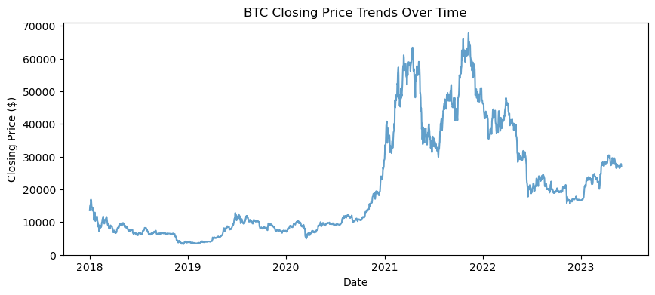
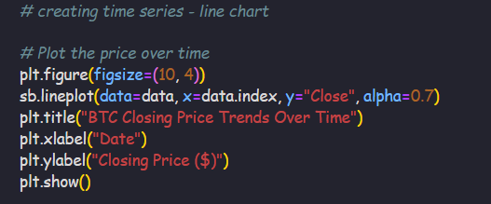
Price-chart : line chart analysis

Slide 17
Feature engineering and indicators
Add following features to indicate the trends
Moving average
Moving averages are technical indicators that smooth out price fluctuations by averaging prices over a specific period, helping traders to identify trends and potential support/resistance levels.
Daily Change %
Daily change shows the daily average changes in the price in percentage
Bollinger bands
Bollinger Bands are a technical analysis tool used to assess market volatility and identify potential trading opportunities, consisting of a simple moving average (SMA) and two bands (upper and lower) typically set two standard deviations away from the SMA.
ATR
The Average True Range (ATR) indicator is a technical analysis tool that measures market volatility.
RSI
The RSI provides immediate signals for buying and selling, helping you understand whether an asset is overbought or oversold.

Slide 18
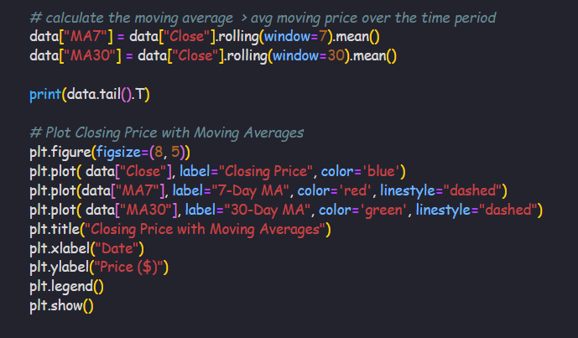
Moving averages

Slide 19
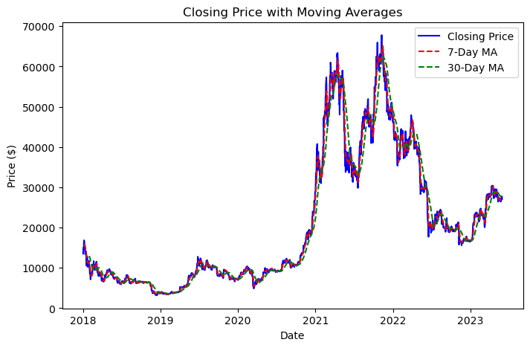
Visualizing the moving averages

Slide 20
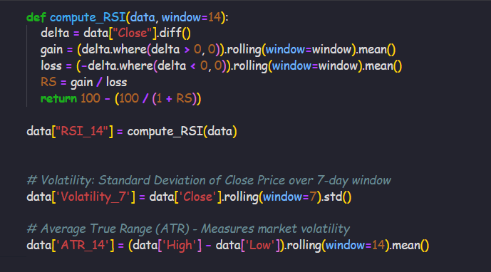
Other indicators

Slide 21
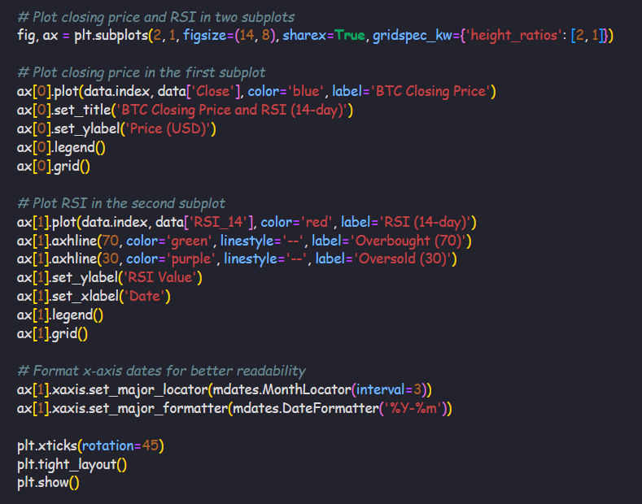
RSI – Relative strength index

Slide 22
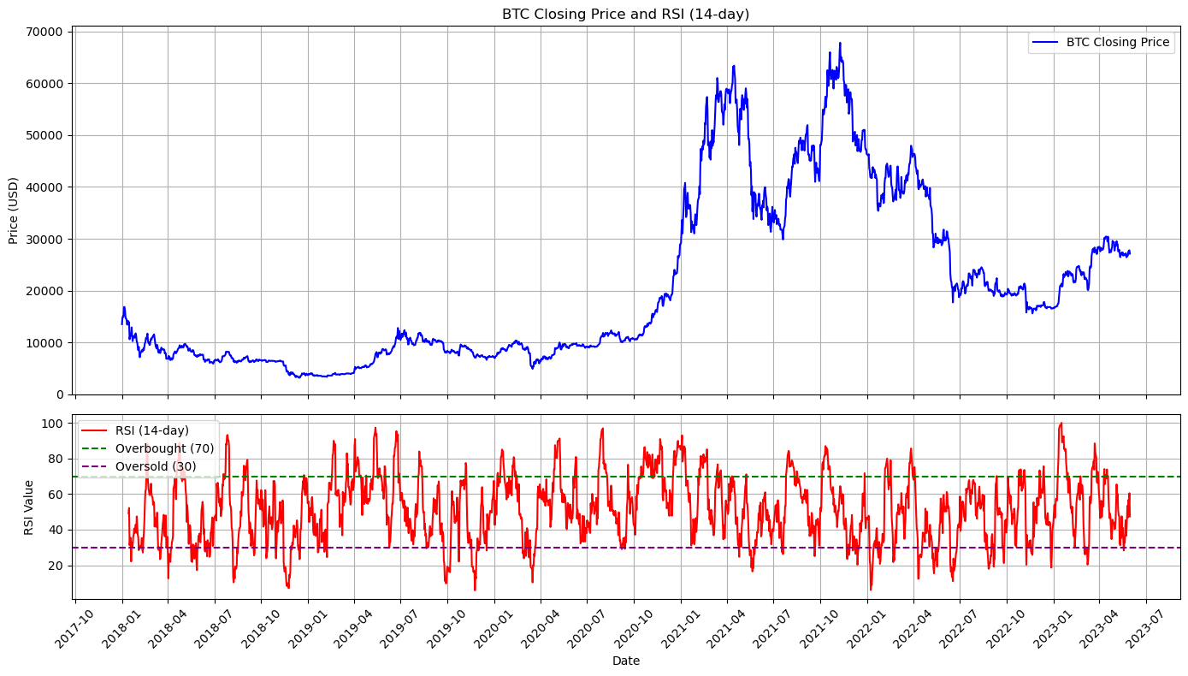

Slide 23
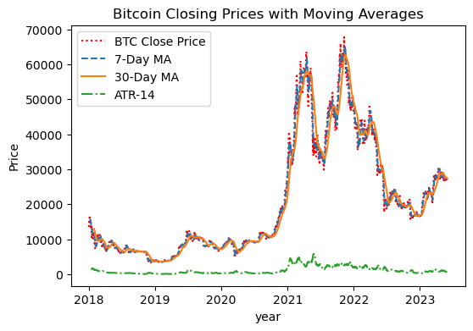
Visualizing the indicators

Slide 24
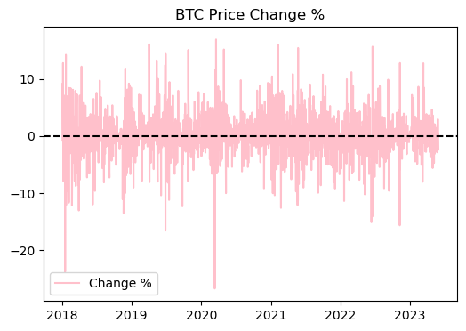
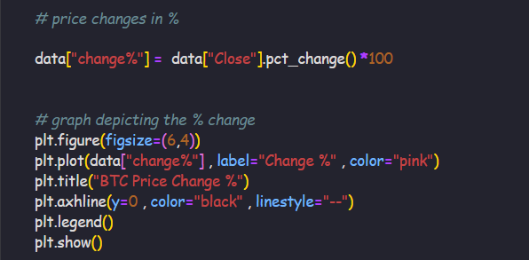
Percentage changes in price

Slide 25
Bollinger Bands
Bollinger Bands are a technical analysis tool that shows the price volatility of a financial instrument over time. It consists of three : upper band, lower band and middle band
In this case :
Upper band = MA30 + (2 * Std Dev.)
Lower band = MA30 - (2 * Std Dev.)
Middle band = MA30

Slide 26
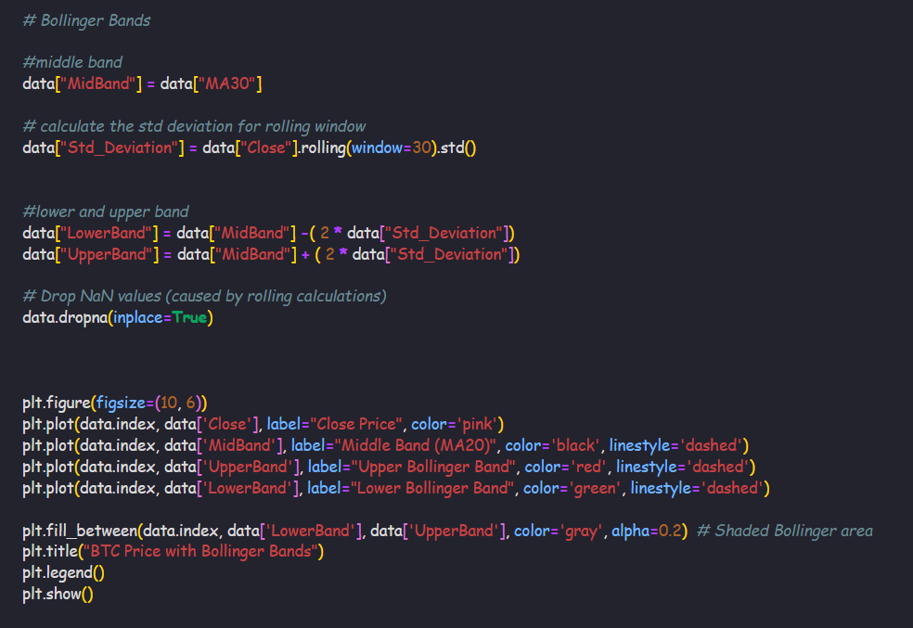

Slide 27
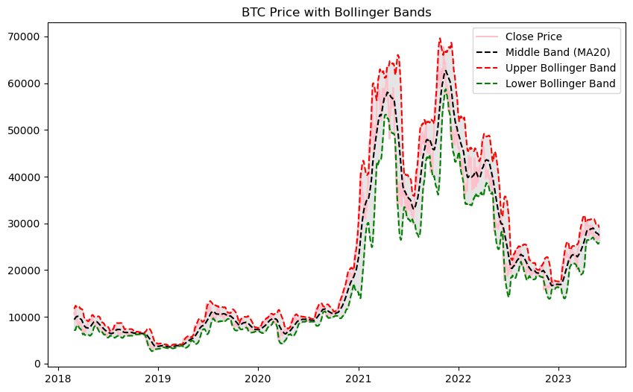
Visualizing the Bollinger's bands

Slide 28
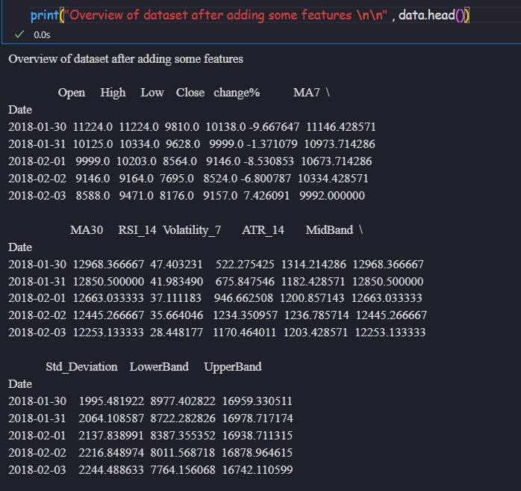
Overview of dataset after EDA

Slide 29
Price Prediction with advance models
XGBRegressor:
The XGBRegressor is a powerful machine learning algorithm that is commonly used for regression tasks. XGBoost uses gradient boosting, where decision trees are built sequentially, and each tree tries to correct the errors made by the previous tree.
Random Forest Regressor:
Random forest regressor model is used for regression tasks and works with continuous or numerous data.
Random Forest is a powerful algorithm for predicting stock prices due to its robustness and ability to handle complex, non-linear relationships in data.
LSTM
LSTM (Long Short-Term Memory) is a type of recurrent neural network (RNN) designed to process and predict sequential data, addressing the limitations of traditional RNNs by overcoming the problem of vanishing gradients.
GRU – Gated Recurrent Unit
It is a type of Recurrent Neural Network (RNN) that excels at processing sequential data.
It's designed to be more computationally efficient and easier to train than Long Short-Term Memory (LSTM)

Slide 30

XGBRegresssor

Slide 31
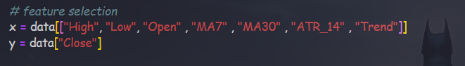
Feature selection and data splitting

Slide 32
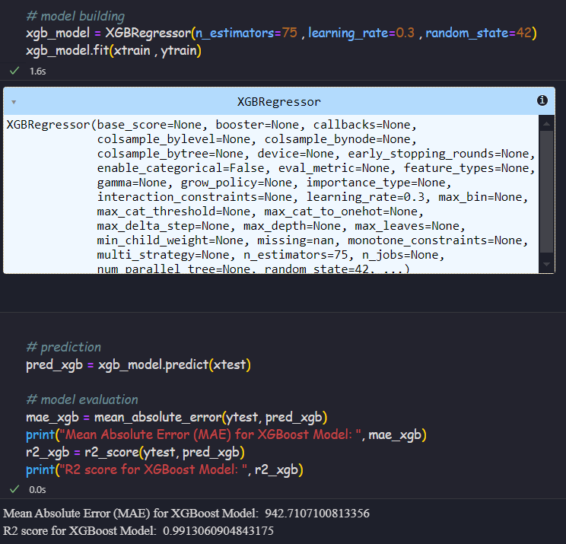
Model & evaluation

Slide 33
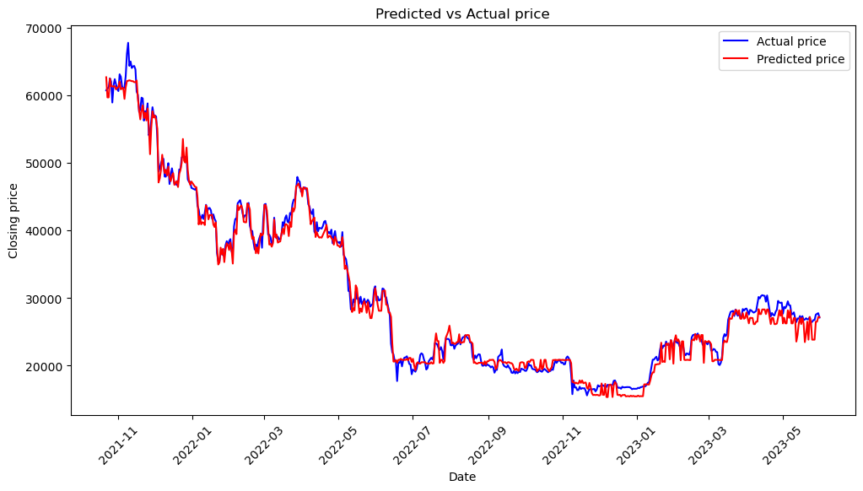
Predicated price vs Actual Price

Slide 34
Evaluation Metrics
MAE: ~942.71 means that, on average, your model's predicted price is off by about $943 from the actual price.
R² Score: ~0.9913 is excellent — this means that your model explains ~99.13% of the variance in the data.
Overall performance of the XGBoostRegressor is evaluated good as per this metrics

Slide 35
Random Forest

Slide 36
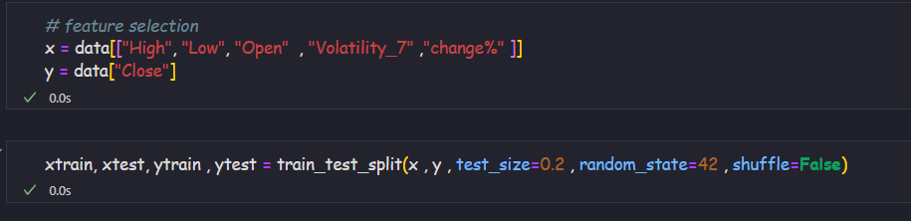
Feature selection and train-test split

Slide 37
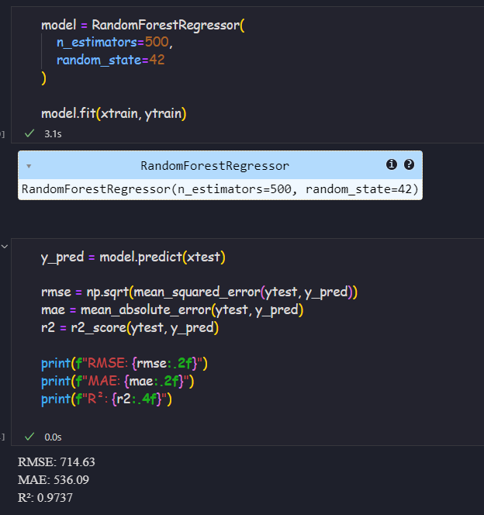
Fit and evaluate the model

Slide 38
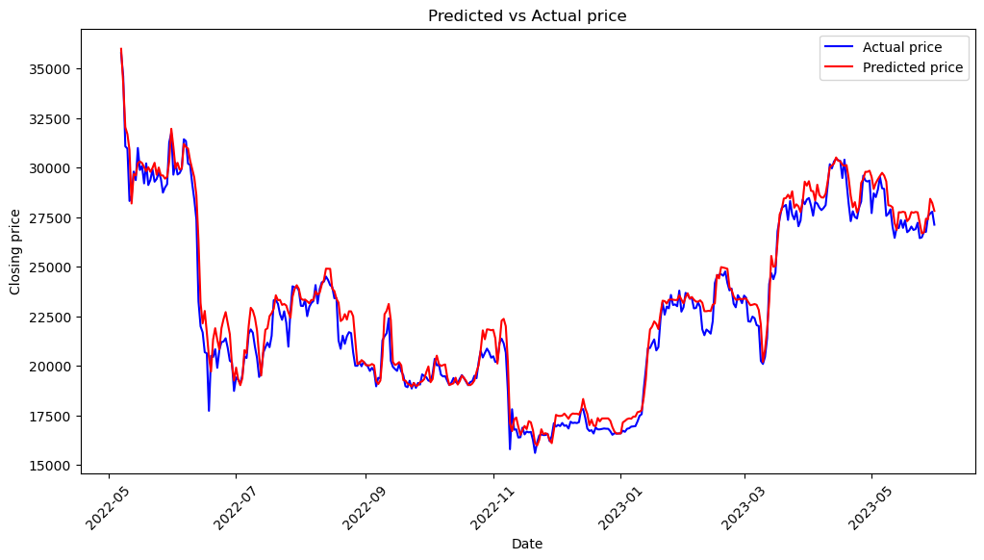
Visualize the predicated prices

Slide 39
Analysis
R² (0.9737): An R² of 97.37% is excellent, indicating your Random Forest model explains nearly all the variance in Bitcoin Close prices.
RMSE (714.63) and MAE (536.09): These errors are small relative to the price scale. With an average price of ~$20,000 (estimated), RMSE is ~3.57% and MAE is ~2.68% of the mean price. For Bitcoin, where daily swings can exceed 5-10%, these errors suggest decent predictive accuracy.

Slide 40

LSTM Model

Slide 41
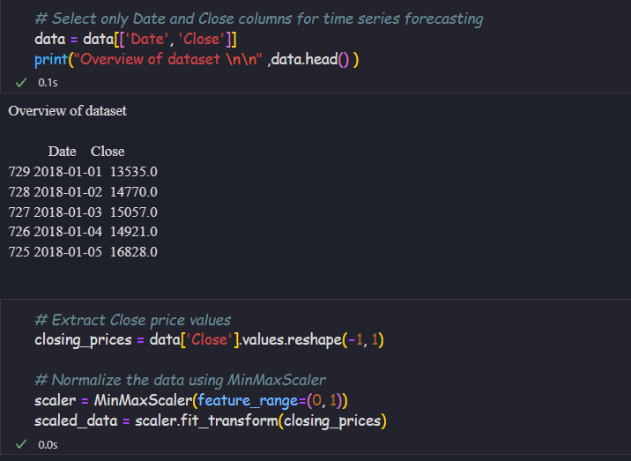
Feature selection and Data Scaling

Slide 42
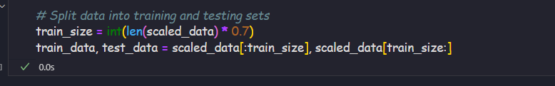
Training and Testing Dataset

Slide 43
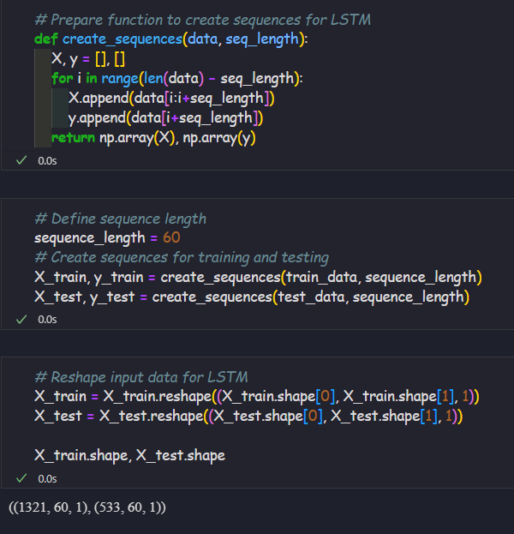
Sequences with length of 60 and reshape the data

Slide 44
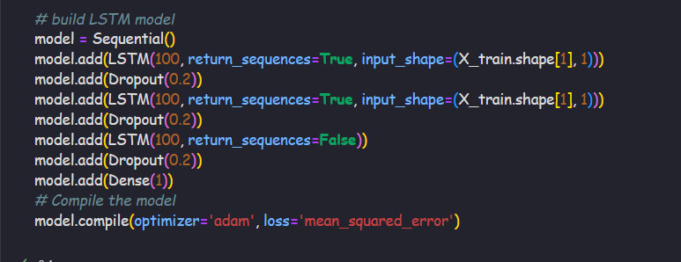
Model building

Slide 45
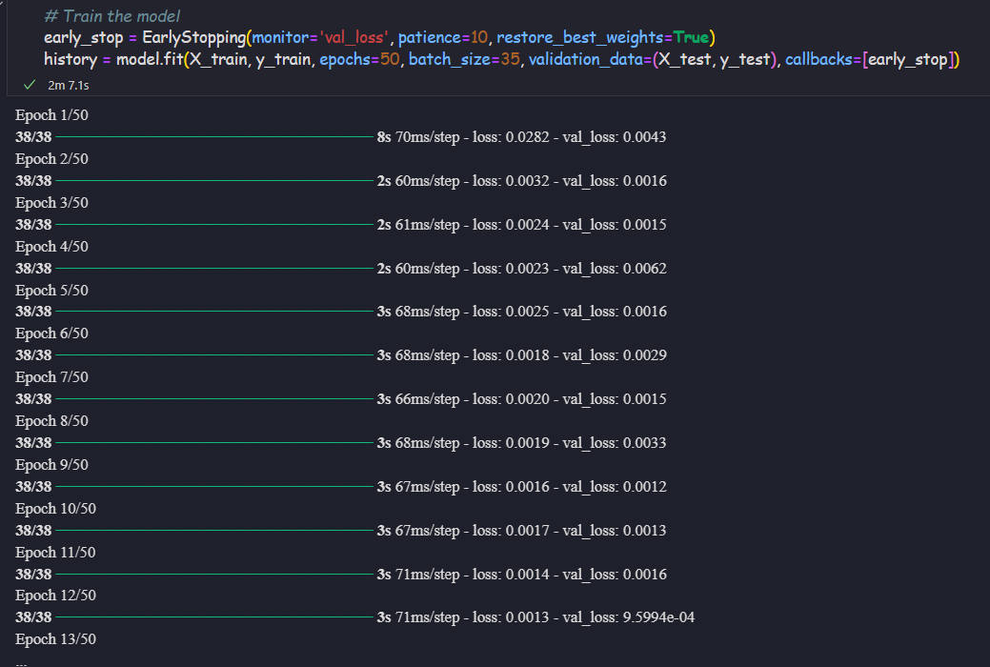
Fit the model with appropriate iterations

Slide 46
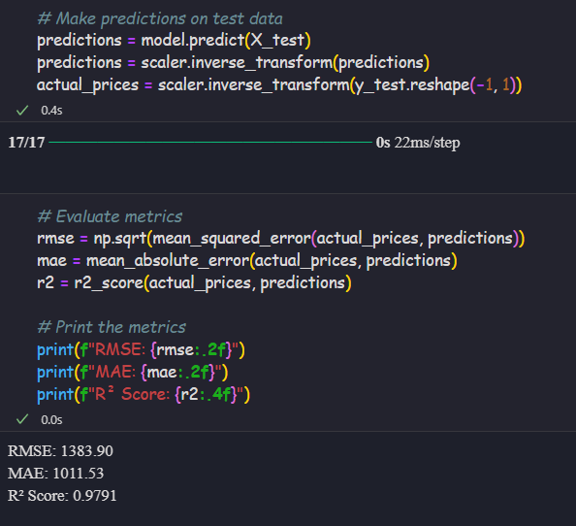
Predictions and model evaluation
Analysis:
RMSE (~1383) indicates that, on average, the model’s predicted price deviates by about $1455 from the actual price. Since BTC prices can be highly volatile, this error is relatively small compared to the typical price range.
R2 score 0.97 indicates that 97.7% of the variance in the BTC price is explained by the model.
Overall, the model is trained and performed well

Slide 47
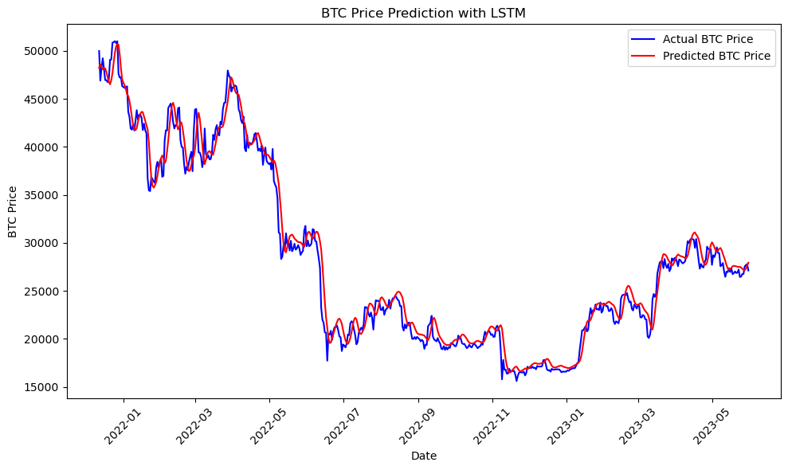
Predicated price vs Actual Price

Slide 48
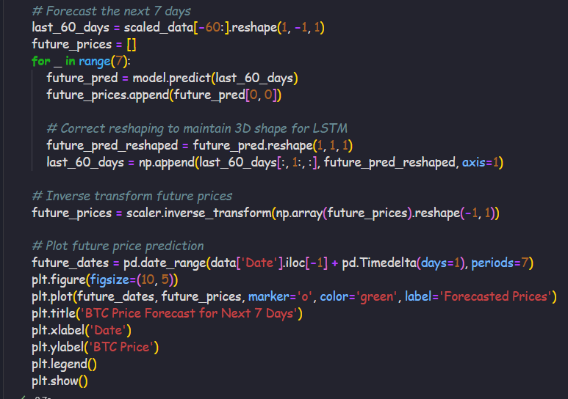
Price forecasting of 7 days based on last 60 days with LSTM

Slide 49
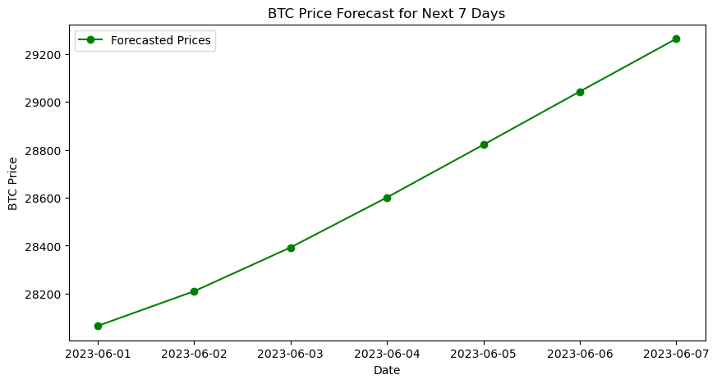

Slide 50
Model Comparison
XGBoost Model:
Fast and accurate for predicting trends and price changes.
Suitable for quick decision-making and broader market analysis.
LSTM Model:
Highly effective at capturing sequential price patterns.
Better suited for 7-day price forecasting with a high degree of reliability.

Slide 51

GRU Model

Slide 52
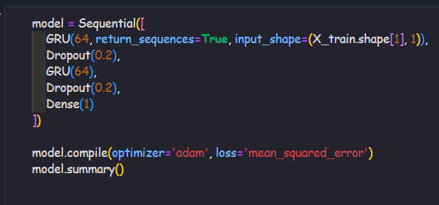
Model building

Slide 53
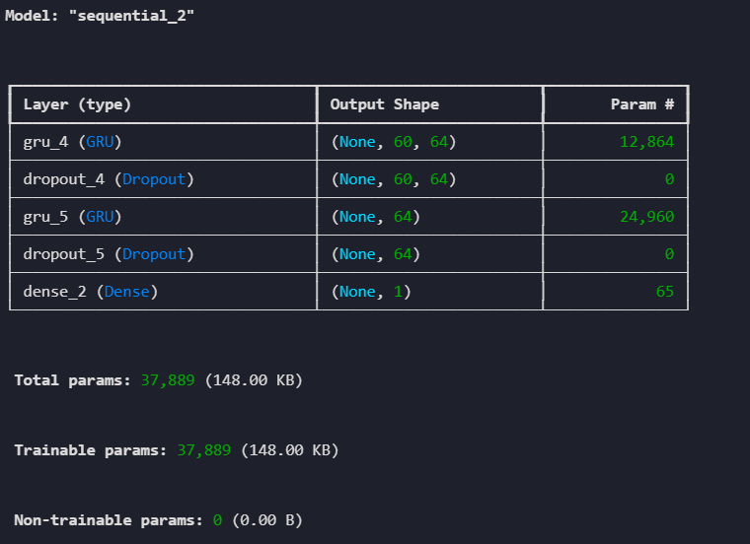
Model summary

Slide 54
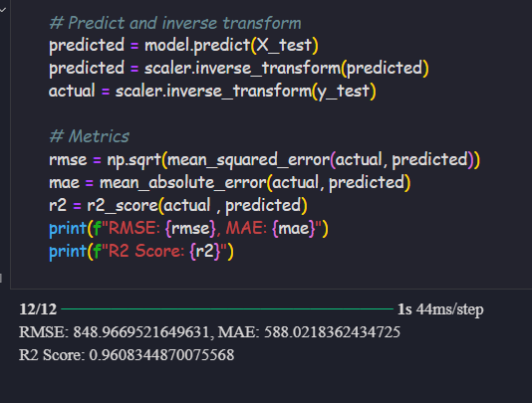
Evaluate the model
The GRU model has also provides the almost same accuracy like LSTM model even though taking less computational resources

Slide 55
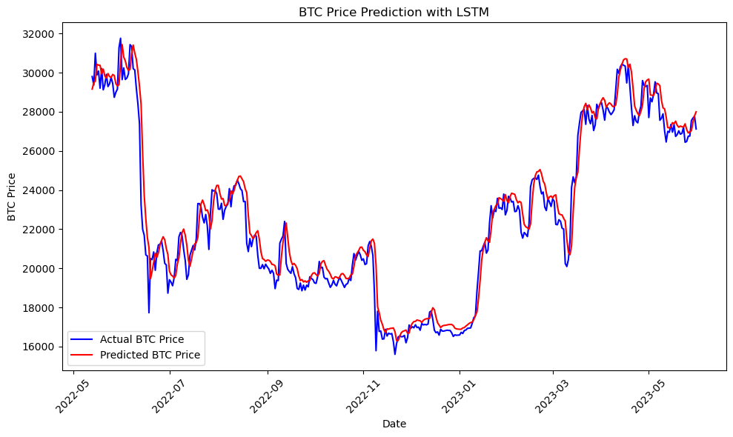

Slide 56
Conclusion
The predictive models (Random forest and LSTM) have shown excellent performance in forecasting BTC prices meanwhile GRU model has performed well with less computing time and resources.
Random Forest excels in explaining variance and handling price trends, while LSTM effectively predicts short-term price movements with minimal deviation.

Slide 57
THANKS!

